Slide 1
Economic impact of Covid19
WEBINAR 30th May 2020
MG Chandrakanth
Former Director, ISEC
Bangalore,
Camp: Washington DC May 29 2020

Slide 2
Coverage
Preamble
Global economic impact of Covid19
Fiscal deficit due to Covid 19
Global economy to face the worst recession
Economic forecasts
World trade forecasts
Unique about Covid19 predicament
Actions of RBI, GOI
How most successful nations fought Covid
Kerala Experience
$1 billion assistance from World Bank
Low oil prices helpful to India
Suggestions

Slide 3
Preamble
Covid19 Virus first diagnosed in Wuhan, China, is detected in > 190 countries - widespread
WHO declared COVID-19 as world health emergency in Jan 2020
By April 2020, focus shifted from EU to US with more than 17 lakh affected, killing more than one lakh (6%)
> 80 countries have closed borders, businesses, schools for 1.5 billion children, self-quarantining
Are we heading towards Malthusian catestrophe?

Slide 4
What is unique about Covid19 shock
First began as a supply shock
But, Global Economy is interdependent as most products are produced as part of a global value chain (GVC): for example car or mobile parts made all over the world before final assembly
Plant closures in China, parts of Asia affected supply chain, dwindling inventories
With the spread of Covid 19 to Europe, supply shock shifted to demand crisis due to physical distancing, travel restrictions, cancelling sporting events, closing shops, restaurants, mandatory quarantine measures

Slide 5
What’s unique about Covid19 shock
Many firms – restaurants, retail operations working on tight margins, can’t pay employees due to closures
Cutting bank rates to near zero (in some cases) cannot compensate for lack of physical interaction - global economy is dependent upon
Fiscal stimulus will thus play significant role to prevent personal and corporate bankruptcies

Slide 6
Global Economic Effects of COVID-19
1. Spread over 190 countries
2. Potential to trim global economic growth by 2.0% per month
3. Risk of global economic recession similar to Great Depression of 1930s.
4. Fall in Global trade by 13% to 32%, depending on depth and extent of global economic downturn.

Slide 7
Global economic impacts of Covid19
> 36.5 million Americans filed unemployment insurance
20 million Americans lost jobs in April 2020
US national unemployment rate pushed to 14.7%, the highest since Great Depression
US GDP fell by 4.8% in the first quarter of 2020, the largest quarterly decline in GDP since 2008, year of global financial crisis

Slide 8
Global economic impacts of Covid19 Contd
> 30 million in EU applied for state support of wages
EU economy reduced by 3.8% at an annual rate, the largest decline since 1995
Foreign investors have pulled out $26 billion from developing Asian economies, > $16 billion out of India, may result in major economic recession in Asia.
29 million people in Latin America can fall into poverty, reversing efforts to narrow income inequality.

Slide 9
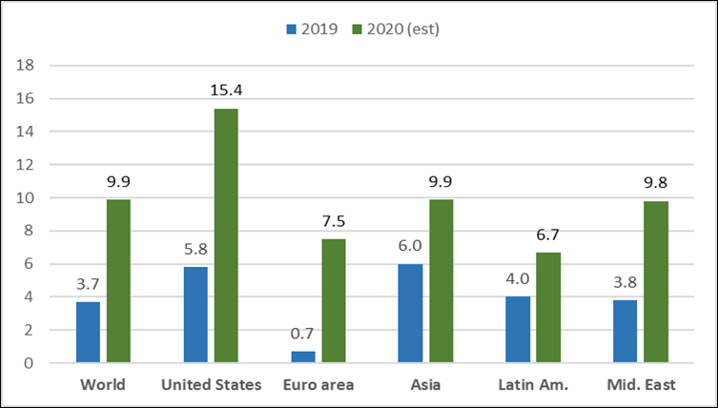
Projected Government Fiscal Balances (fiscal deficit) Relative to GDP as percentage of Gross Domestic Product

Slide 10
Fiscal deficit will increase from 3 % of GDP
Fiscal balance (difference between govt revenues and expenditures) : Most Governments kept this at 3%
Acc to IMF, increase in borrowing by governments globally will rise from 3.7% of global GDP in 2019 to 9.9% in 2020
For the US, fiscal deficit rises from 5.8% to 15.7% of GDP, for EU more than 10% of GDP; for developing economies, from 4.8% to 9.1% of GDP - this will increase their debt burden
Most fiscally vulnerable countries are: Argentina, Venezuela, Lebanon, Jordan, Iran, Zambia, Zimbabwe, and South Africa

Slide 11
Global economy will experience the worst recession – IMF
The global economy to fall by 3.0% in 2020
May grow by 5.8% in 2021
All countries to experience negative growth rates in GDP in 2020 except China, India
Only China (1.2%) and India (1.9%) may have positive growth rates in real GDP in 2020
India to experience the highest growth rate of GDP compared to all countries in 2020 (1.9%).
Volume of world trade to fall by 11% in 2020
Oil prices to fall by 42%

Slide 12
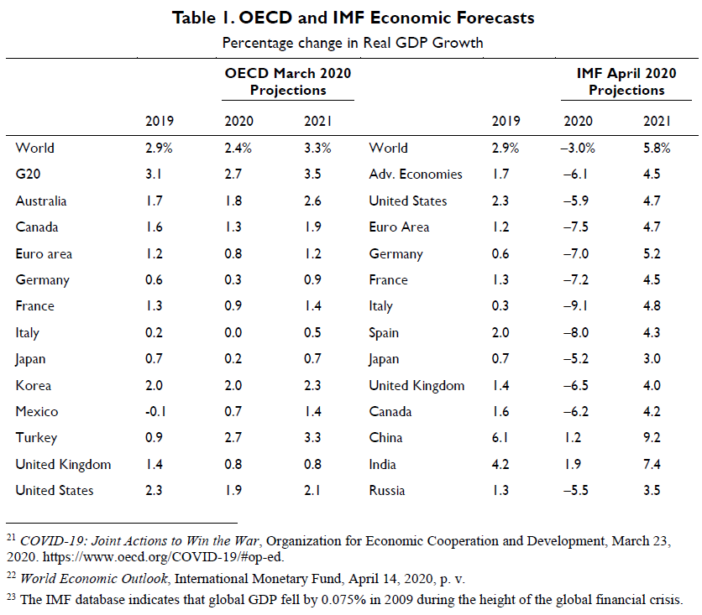
ECONOMIC FORECASTS
Global economy can fall by 3 % in 2020, may grow by 5.8% in 2021.Global trade may fall by 11% in 2020, oil prices may fall by 42%

Slide 13
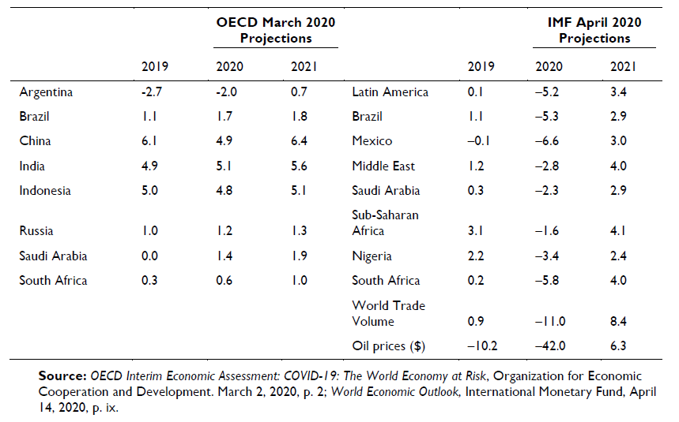
Economic forecasts (% change in real GDP growth (contd)

Slide 14
OECD forecast
The economic effects of Covid19 varies across countries due to differences in timing and degree of restrictions
Greatest impact is on retail and wholesale trade, professional and real estate services.
Closure of Business reduces economic output by 15% to 25%
Countries dependent on tourism affected severely
Countries with large agricultural and mining sectors to experience less severe effects.

Slide 15
World Trade affected due to Covid19
WTO: global trade to fall between 13% and 32% in 2020
Impact on global trade volume can be more than the drop in global trade during the height of the 2008-2009 financial crisis
All regions will experience double-digit fall in trade volumes, except Africa, Middle East, Commonwealth of Independent States.
North America and Asia experience steepest decline in export volumes
Sectors with extensive value chains - automobile products, electronics to experience the steepest declines
Services are not included in WTO forecast - but economy to experience largest disruption due to restrictions on travel , transport closure of retail, hospitality
Information technology may grow due to work from home

Slide 16
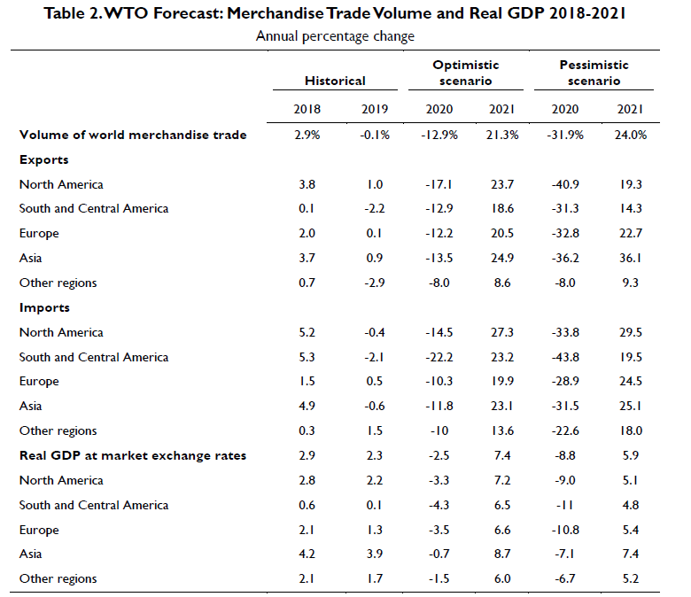
WTO Forecast of Trade and GDP

Slide 17
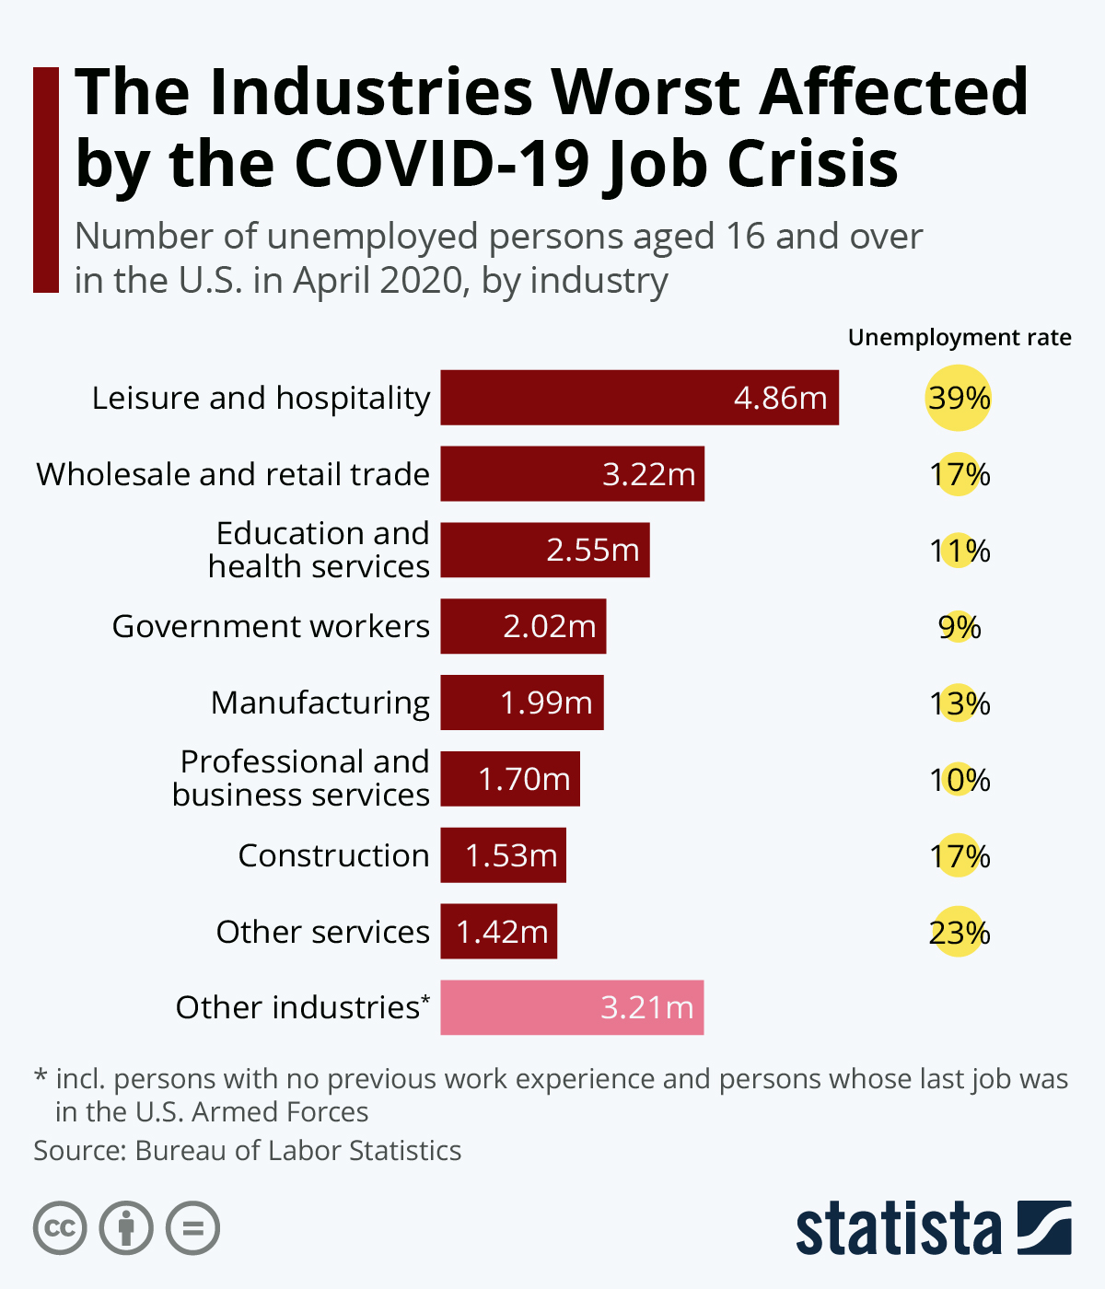

Slide 18
Economic impact of Covid19 in India and measures taken
GDP to reduce by 40%
Unemployment increased from 6.7% on 15 Mar to 26% on 19 April.
During lockdown, 140 million people lost employment
Atleast 45% of households reported an income drop as compared to the previous year
Loss of Rs. 32,000 crores (US$4.5 billion) every day during the first 21 days of lockdown
65% of India’s economy is unorganized - the most affected including MSMEs. Workers in informal sectors and daily wage workers the most at risk
With complete lockdown, less than 25% of India’s economy of $2.8 trillion was functional.
53% of businesses significantly affected
Supply chains under stress due to lockdown restrictions
Farmers cultivating perishables facing uncertainty,
Hotels and airlines, are cutting salaries and laying off employees.

Slide 19
Economic impact and measuers taken
26 Mar 2020: Govt announced economic relief measures for the poor worth Rs. 1,70,000 crores (US$24 billion).
27 Mar 2020: RBI announced a number of measures making available Rs 374,000 crores (US$52 billion) to financial system
3 Apr 2020: GoI released Rs. 28379 crores (US $ 4 billion) to states for tackling Covid19
World Bank and ADB approved support to India to tackle the pandemic

Slide 20
Economic impact and measures taken
17 April 2020. RBI released Rs 50,000 crores (US$7.0 billion) special finance to NABARD, SIDBI, NHB
18 April 2020: to protect Indian companies from pandemic, GOI changed FDI policy putting on hold all capital acquisitions
The Defense Chief announced minimizing costly defense imports to give opportunities for domestic production; also making sure not to "misrepresent operational requirements
12 May 2020, PM announced overall economic package worth Rs 20 lakh crores (US$280 billion), 10% of India's GDP emphasizing, on self reliance. This included free food grains package also (Athmanirbhar Bharath Abhiyan – Self reliant India Mission).

Slide 21
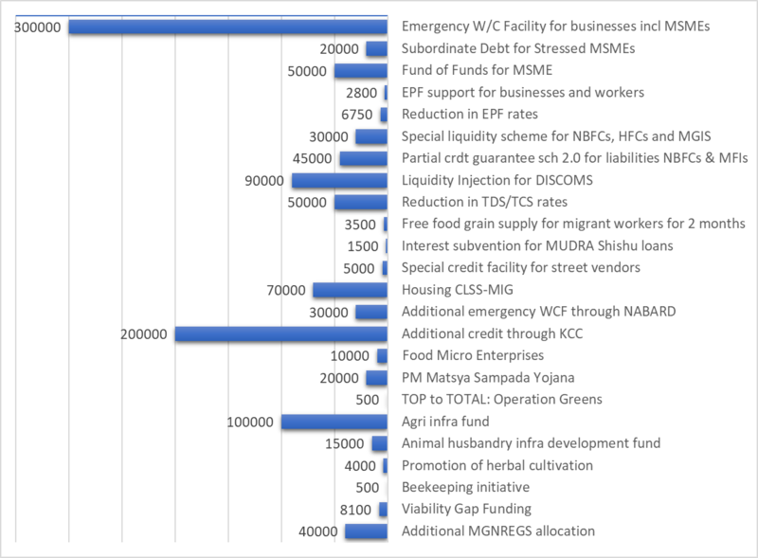
GOVT OF INDIA MEASURES TO FACE ECONOMIC IMPACT OF COVID19

Slide 22
ECONOMIC PACKAGE OF GOI of Rs. 20 lakh crores (10% of GDP) 12TH May 2020
Rs. 8 lakh crores (US$110 billion) liquidity
Rs 170,000 crores (US$24 billion) for fiscal and monetary, liquidity measures
India's fiscal stimulus as a percentage of GDP varied between 0.75% to 1.3% to encourage private sector economic activity
Fiscal stimulus measures are deficit spending and lowering taxes;
Monetary stimulus measures are lowering interest rates, increasing Govt spending to elicit response from private sector economy.

Slide 23
Protectionism
18 April 2020, India changed its FDI policy to curb "'opportunistic takeovers/acquisitions' of Indian companies due to the current pandemic
With the fall in global share prices, China may take advantage of the situation, leading to hostile takeovers
The new FDI policy ensures that all FDI from countries that share a land border with India will now be under scrutiny of the Ministry of Commerce and Industry

Slide 24
Alternative to China
Govt of india is attracting companies that wish to move out of China or are looking for an alternative to China
PM's office is conveying state machinery for pro-investment strategies earmarking at least 461,589 hectares for the purpose
The China plus one strategy for shifting numerous Indian companies shifting manufacturing partly or completely out of China
The Govt of Karnataka is also following a "Compete With China" cluster strategy forecasting "large-scale manufacturing“.
In mid-May, the German footwear brand, Von Wellx, decided to shift its entire operations from China to India.

Slide 25
Economic impact of Covid19
53% of businesses have indicated impact of shutdowns due to COVID-19
24 April 2020: Unemployment rate increased to 26%
14 crore Indians lost employment due to lockdown
More than 45% households reported drop in income compared to 2019
Hotels and airlines are cutting salaries and laying off employees
Revenue of Ola cabs reduced by 95% in Mar-April 2020 resulting in 1400 layoffs.
Loss to tourism industry - Rs.15,000 crores (US$2.1 billion) for Mar-Apr 2020 due to unemployment.
Live events industry faced estimated loss of 3,000 crores
Venture Capital in Indian startups fell by 50%
Govt revenue affected due to reduced tax collection and hence Govt is trying to reduce its own costs.[

Slide 26
Economic impact of Covid19
SBI research predicts a contraction of 40% in the GDP in Q1 FY21
For states, total loss is estimated at 13.5% of the total GSDP
12 April 2020, World Bank - India's economy is expected to grow 1.5% to 2.8% for FY21, the lowest since liberalization
World Bank report : Pandemic has "magnified pre-existing risks to India's economic outlook”
Mid-April the IMF projection for India for 2021 of 1.9% GDP growth was still the highest among G-20 nations
The Confederation of Indian Industry estimated that India's GDP for FY21 will be between 0.9% and 1.5%

Slide 27
Fall in demand for energy
The night lights and economic activity are related. In Delhi, night light demand fell by 37%, by 32% in Bangalore , by 29% in Mumbai
India's fuel demand in April 2020 as compared to previous year fell by 46%.
LPG sales rose by 12%.
India's annual fuel consumption to decline 5.6% in 2020. Diesel demand will drop by 6%.
Oil prices dropped sharply in 2020 and demand also fell sharply.
By mid-May India filled its storage of oil including ships across the world.
India is now looking at storing oil in other nations including America and plans to increase local strategic storage capacity for oil

Slide 28
Loss in Agriculture
10% of farmers could not harvest their crop in the past month and 60% of those who did harvest reported a yield loss
Majority of farmers are facing difficulty for next season
Tea estates unable to harvest. Hence Darjeeling tea will face significant fall in revenue and Tea exports could fall by 8%
During lockdown, food wastage increased due to affected supply chains, affecting small farmers.
20 April 2020: dairy, tea, coffee, and rubber plantations, associated shops and industries, will reopen
By April end, Rs17,986 crores (US$2.5 billion) transferred to farmers under the PM - KISAN scheme
Odisha passed new laws promoting contract farming

Slide 29
Loss to Manufacturing
Larsen and Toubro, Bharat Forge, UltraTech Cement, Grasim Industries, Aditya Birla Group, Tata Motors, Thermax, iPhone producing companies have temporarily suspended or significantly reduced operations in a number of manufacturing facilities and factories across the country
All 2 wheeler and 4 wheeler companies have put a stop to production till further notice.
Hindustan Unilever, ITC , Dabur India have shut manufacturing facilities except for factories producing essentials.

Slide 30
Impact on stock markets
ಅರ್ಥಾತುರಾಣಾಮ್ ನ ಗುಣೋ ನ ಧರ್ಮಹ
23 Mar 2020: Stock markets posted worst losses in history
SENSEX fell 4000 points (13.15%)
NSE NIFTY fell 1150 points (12.98%)
25 March 2020, one day after complete 21-day lock-down was announced the SENSEX posted its biggest gains in 11 years, adding a value of Rs. 4.7 lakh crores (US$66 billion) crore for investors.
8 April, following positive indication from Wall Street that the pandemic may have reached its peak in the US, stock markets in India rose steeply once again
By 29 April, Nifty reached 9500 mark.[

Slide 31
Impact on E - commerce
3rd week of March: Amazon stopped sale of non-essential items in India and focussed only on essential needs as followed in Italy and France.
Similarly , 25 March, Walmart owned Flipkart suspended services on e-commerce only selling and distributing essentials.
BigBasket and Grofers also restricted services due to lockdown.[
Lack of clarity regrding essentials and non essentials.

Slide 32
Impact on Defence
Defence has postponed all capital acquisitions until coronavirus pandemic recedes
No new major defense deals will be made in the beginning of financial year 2020–21.
May: Defence emphasized need to minimize costly defense imports and boost domestic production : 'Make in India' by hand-holding our domestic industry even if they deliver weapons with only 70% of the GSQRs (general staff qualitative requirements) in the beginning…given the opportunity, they will eventually deliver cutting-edge technology
Finance Minister announced change in the FDI cap from 49% to 74% for defense, the corporatization of India's ordnance production and a list for the ban of select defense imports.

Slide 33
Economic danger Vs Health risk
Adar Poonawalla, CEO of Serum Institute of India said: "the economic danger of the outbreak was exponentially greater than its health risks”
29 April, NR Narayana Murthy said that if the lockdown continues, India may see more death due t
29 Mar: Govt allowed movement of all essentials and non-essential goods during lockdown.

Slide 34
Impact on salaries
19 March 2020: PM appealed businesses and high income segments to take care of the economic needs of workers
Appealed to families not to cut pay of domestic help
Govt circulated advisories to keep paying employees where contractual, casual and outsourced staff of Ministries/Departments and other organization of Government of India are required to stay at home due to lockdown treating them "on duty“
15 May, Supreme Court announced - government should not take "coercive action" against employees for not paying wages during the lockdown.

Slide 35
Migrant workers - due to lock down
Daily-wage workers (urban poor and migrant laborers) due to lock down were walking back to villages due to absence of transport, many died in accidents
State governments set up 21,000 camps to house 660,000 migrants to stop exodus
500 hunger relief centres were set up by the Delhi government by March end.
5 April : 75 lakh people provided food in food camps by the government and NGO
12 April, 37,978 relief camps and 26,225 food camps were set up
Migrants in Kerala provided with medical essentials - masks, sanitizers, and medicines
FM announced Rs. 1.7 lakh crore (US$24 billion) spending for the poor – through cash transfers, food security
April 1, 2020: MGNREGA wages were increased by 11% from Rs. 182 (2.6USD) to Rs. 202 (US$2.80)
14 May, 2020: Free food grains for 80 million migrant workers spending Rs.35 billion (US$490 million)
May 1-21: Railways transported 31 lakh migrants to their homes in special train and GOI paid the fare

Slide 36
Other steps taken due to Covi19
GoI suspended MPLADS for two years
State governments incurred huge losses and may have to cut capital expenses to find alternate ways to pay salaries.
Delhi government fallen 90% short in tax collection as compared to 2019, is planning to raise loans and taxes.
Maharashtra has put a hold on all new capital works till March next year; spending under government development schemes reduced by 67% for current fiscal.
Delhi and AP governments imposed 70%-75% "corona" extra tax on liquor. Excise duty on liquor is the third largest source of income for a number of states, nearly 10-15% of total tax collection for some states.

Slide 37
KERALA EXPERIENCE
Smt KK Shailaja, Health minister ordered the four international airports to screen passengers in January, isolating those with symptoms. 24
24-member state response team with police and public officials across Kerala.
Health-care system the best in India, world-class nurses, life expectancy in Kerala the highest in the country.
Sri P.B. Nooh IAS (Kerala), Sri PB Salim IAS(West Bengal) brothers, played key role in control of Covid 19.
Sri Nooh devised a strategy with help of police tracing and home quarantining all contacts of 4,000 people, including 2,000 from foreign countries,

Slide 38
KARNATAKA EXPERIENCE
Karnataka State built a network of 30,000 volunteers to fight spread of Covid 19 and help the most vulnerable.
Digital technology used in developing the systems necessary to manage this workforce.
The doubling rate of new COVID-19 cases slowed down from 3.5 days to 7.5 days
Leadership of CM Sri BS Yediyurappa – created task forces, control centres with volunteers, industry leaders, doctors, IT professionals, paramedics, police officers, civil defence personnel, support of the Indian Red Cross Society – steered by Captain P Manivannan, IAS

Slide 39
Karnataka Covid19 experience
March 2020 : Govt of Karnataka launched ‘Corona warriors’ with volunteers from all walks of life to fight the pandemic
With the objective of No one goes hungry + everyone stays safe: Volunteers helped build technological and medical infrastructure, offered telemedicine support from doctors, shadowed police personnel in enforcing the lockdown, cooking and serving food for migrant labourers.
80% of the queries on Social media through helpline and group called ‘Sahaya’ set up were related to non-COVID-19 emergencies such as delivering medicines to elderly as they are housebound, securing curfew passes from police for emergencies, bringing food and essentials to individuals under quarantine, ensuring migrant labourers and informal workers to have access to groceries and food when they have no job and no earnings.
Such ration and food requests were converted into tasks by the state's digital command centre, and assigned to volunteer teams to meet the requests

Slide 40
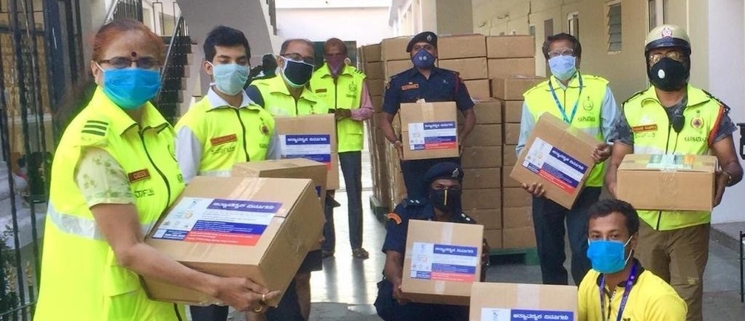
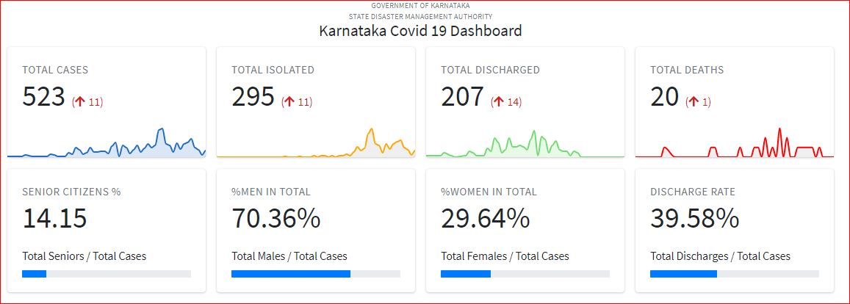

Slide 41
Actions of RBI
Mar 12: $2 billion injection into foreign-exchange market to support the rupee.
Mar 13: Announced a plan to add liquidity through short-term repurchase operations.
Mar 14: Plans to infuse 250 billion rupees ($3.4 billion) into the system through short-term repurchase operation.
Mar 19: Announced that it will buy bonds in the open market for 100 billion Indian rupees ($1.35 billion) due to mature between 2022 and 2025 to keep all market segments liquid and stable.
Mar 27: Lowered benchmark repo rate by 75 basis points to 4.40% and announced steps to tackle the impact of COVID-19 on various industries from the lockdown, such as cutting banks’ cash reserve ratio and targeted long term repos operations. Reverse repo rate was reduced by 90 basis points to 4%.

Slide 42
Actions of Govt of India
Mar 15: Pledged $10 million towards SAARC “COVID-19 emergency fund
Mar 15: “pushing” state-run banks to approve new loans worth Rs 500 billion-600 billion by end of March.
Mar 26: Rs 1.7-trillion ($22.6 billion) economic stimulus - direct cash transfers and food for 200 ml women and elderly people, free cooking gas cylinders to 83 ml poor families, feed 800 ml poor people for next 3 months providing free of cost to each person 5 kgs of wheat or rice, plus one Kg of pulses for every low-income family.
Medical insurance cover of Rs 5 ml ($66,000) for every frontline health worker, from doctors, nurses and paramedics to those involved in sanitary services.

Slide 43
Malthusian catastrophe ?
The preventive checks to population growth are already visible as population growth rates are slowing down in many parts of the world and in some countries reached zero
Positive checks - Great Bengal Famine wiping 5% of the population in Bengal, Spanish flu of 1918 killing 17 million to 50 million, Mad Cow disease, SARS of 2003, Swine flu pandemic (H1N1), Covid 19 in 60 lakhs, killing 3.6 lakhs out of 30 lakhs of active cases killing 12 percent of the active cases
Yes, thanks to Green Revolution –food production growth rate above the growth rate of population disproved Malthus Maths
But we could not yet disprove the operation of checks
The numbers lost are not abstract numbers of statistics, but this is losing father, grandfather, mother grandmother, children, husband, wife, children in families. But the trauma of losing near and dear cannot be brushed aside reminding us the operation of Malthusian limits at least till the medical research / innovations to address the positive check becomes operative

Slide 44
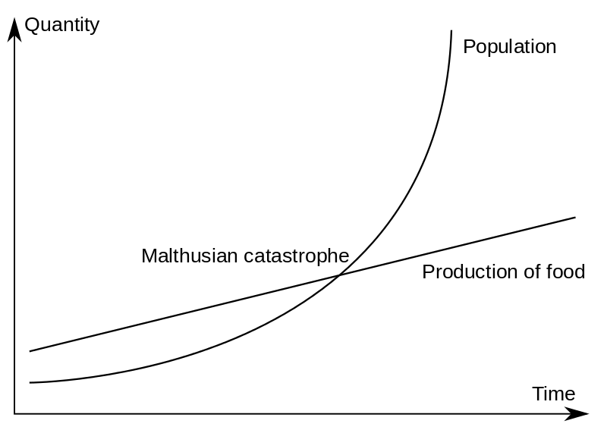
Covid19 reminding Reverend Thomas Robert Malthus ??
We realized higher growth rate in food production than the growth rate in population, but could not win over checks

Slide 45
Most successful nations fighting Covid
New Zealand
Mar 19: PM Ardern shut down travel to NZ banning all foreigners from entering ; Called on New Zealanders to confront this crisis by protecting their fellow citizens; Everybody to behave for the good of everybody; By May end, NZ had 1,500 cases, only 24 deaths (1.6%)
South Korea, Hong Kong, Taiwan, Vietnam: Banned incoming visitors early in the outbreak or placed them in two-week quarantines. South Korea quickly developed its own testing system
German Chancellor Angela Markel (PhD in Quantum chemistry) TV speech:
Power down the public life as much as possible, no events, no trade fares, no concerts, restrictions on entry of visitors , food supplies guaranteed , bulk buying is ok, but not panic buying, indiscriminately the virus can affect anybody, so each one and every one must help, take things seriously, needs collective effort, Every individual counts, keep half meter distance, no more hand shakes, wash hands often and thoroughly, abide by rules and stay in one place, our success depends on how disciplined we are in following rules
PM Modi took similar immediate steps with regard to lock down and announcing Covid 19 package
INDIA
Given the size of India in terms of population, India’s achievement is spectacular in controllign Covid19

Slide 46
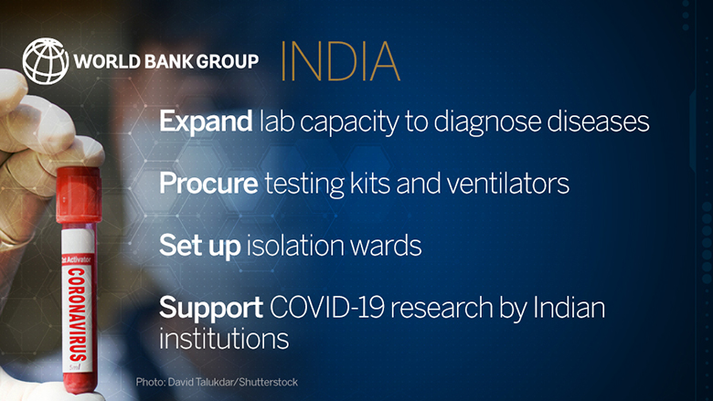
World Bank Fast-Tracks $1 Billion COVID-19 (Coronavirus) Support for India

Slide 47
IMF $ 1 billion assistance (Rs 7500 crores)
The project will immediately enable the Government of India (GOI) to scale-up efforts to limit human-to-human transmission
project will also enhance the resilience of India’s health system to provide core public health prevention and patient care to better manage COVID-19
build a network of high containment Biosafety Level 3 laboratories.

Slide 48
IMF predictions
IMF: India’s growth rate can be 7.4% in 2021 if coronavirus outbreak is brought under control
First, bring coronavirus outbreak under control to end nationwide lockdown
Second, to inject more stimulus into the economy
Low oil prices gives the boost to Indian economy

Slide 49
Low oil prices helpful for India
> 80% of India’s oil is imported, hence falling oil prices can reduce India’s inflation and lower the cost of import bill, help narrow trade and current account deficits.
Low oil prices will support discretionary purchasing power (for the Government, not for consumer, since taxes are not reduced)
For every dollar drop in oil price, India saves $1.5 billion (Rs 11250 crores)
This will help alleviate fiscal pressures
But this is offset by weaker rupee, hence benefits are not as much as originally anticipated. Rupee weakened from Rs. 70 to 75
But benefit from low oil prices can wipe out if there is a sudden, rapid coronavirus outbreak , similar to Italy, Iran, South Korea.

Slide 50
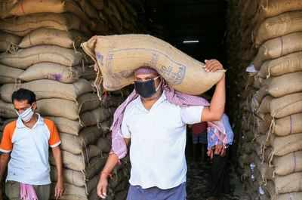
India has buffer stock of 55.5 million tonnes as against 21 million tonnes as buffer stock

Slide 51
My suggestions
According to Harvard epidemiologist Marc Lipsitch Covid 19 could infect 40-70% of the global population. The virus will continue to haunt us despite vaccine, as vaccination also takes time
Currently sector wise contribution to GDP In India, Agriculture 17%, Industry 29%, Services 54%; Trade forms 43% of GDP in India (China 38%, South Koera 83%).
1. Strengthen market infrastructure for farm produce, e-markets, MSMEs to boost domestic entrepreneurs, innovators, industrialists, farmers as excessive dependence on trade may affect domestic economy
2. Stop or reduce, over production in agriculture: for instance our buffer stock of 55 million tonnes forms 19% of our production of food grains of 290 ml tonnes and can be reduced to 10% as water is precious and scarce, most of the water goes for food like rice

Slide 52
Suggestions, contd
3. India Nominal GDP: $2.94 trillion-, GDP (PPP): $10.51 trillion. Is this sustainable given our resources ?. Instead focus on achieving growth rate which is sustainable
4. More is no good. Sustainable is good. Be conservative and realistic with regard to achieving growth rates beyond 5 to 7 percent. Instead focus on income distribution, reducing income, wealth, asset inequalities, and focus on sustainable development. Low growth rate with good income distribution
75% of India’s tax revenues are from urban areas. Even then are huge anomalies in urban property tax collection. For instance only 50% of the urban properties are taxed upto around 50% of the potential. Therefore need to improve governance for proper mop up of urban property taxes
Gandhian Economics, strengthen sharing , cooperatives, self help and mutual help, self reliance, should find appropriate place in teaching curriculum as well as in policy making. For instance, Cooperatives have virtually vanished (except Milk coops), similarly Kirana Shops are vanishing due to Malls.

Slide 53
Be careful suggesting Value addition in food industry
The food industry is vulnerable for value addition
Primary value addition should be encouraged: Ex: ದಾಳಿಂಬೆ ಸುಲಿಯುವುದು, ಹಲಸಿನಹಣ್ಣು ಸುಲಿಯುವುದು, ಪೈನೆ ಆಪಲ್ ಹೆಚ್ಚಿ ಮಾರುವುದು, ಬೆಳ್ಳುಳ್ಳಿ ಸುಲಿದು ಮಾರುವುದು, ಈರುಳ್ಳಿ ಹೆಚ್ಚುವುದು, ಸೀತಾಫಲ ಹಣ್ಣಿನ ಬೀಜ ತೆಗೆದು, ಹಣ್ಣನ್ನು ಮಾರುವುದು, ಸಿರಿಧಾನ್ಯಗಳ ಮೇಲಿರುವ ಹೊಟ್ಟುತೆಗೆಯುವುದು
But avoid secondary and tertiary value addition as they are not good for health: Eg: Jam, Jelley, Marmalede, High fructose corn syrup, and all processing which involves addition of preservatives, chemicals, will add to ill health.

Slide 54
My suggestions contd
GST should be reduced to around 10 percent for most commodities, should be 18 to 28 percent for all other luxuries
Appropriate policy for urban property tax collection
Taxing super rich is crucial and vital
Health insurance for informal workers, formers, construction workers
Pension for farmers, informal workers
Wage rate assurance
Creation of awareness about endemics should be a continuous process and hence creating HEALTH EXTENSION ON PAR WITH AGRICULTURAL EXTENSION IS CRUCIAL TAKING HELP OF ASHA WORKERS.

Slide 55


Slide 56
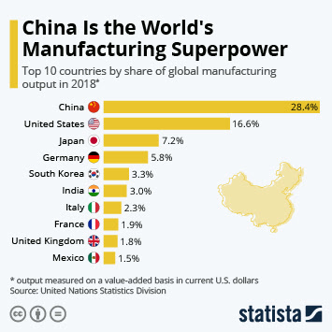
Excessive dependence on trade can erode domestic skills, labor, markets, domestic demand which can never be recovered

Slide 57
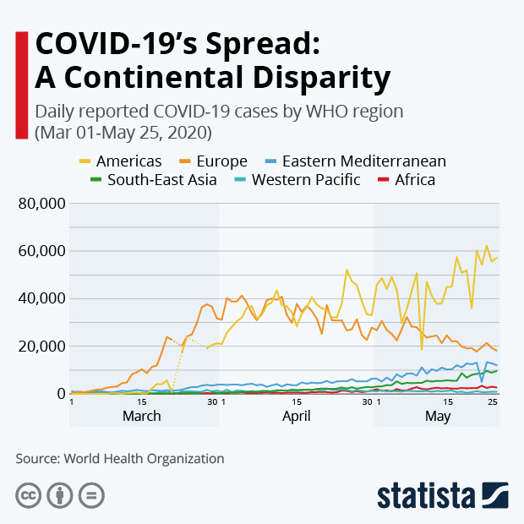
COVID19 spreading fast
In EU, US

Slide 58
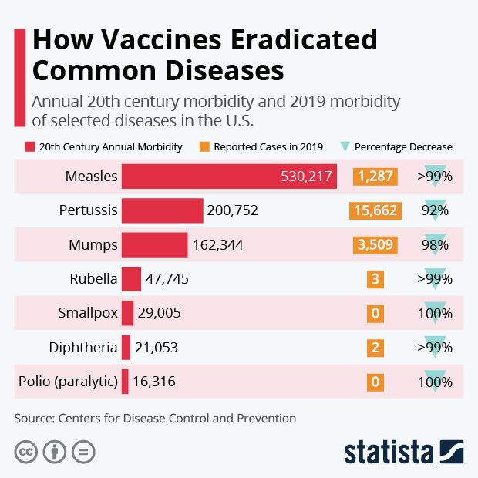
DESPITE THE USE OF VACCINES IN
PUBLIC HEALTH, THERE ARE DOCTORS
IN THE US WHO OPENLY OPPOSE
THAT VACCINATION HAS NO USE

Slide 59
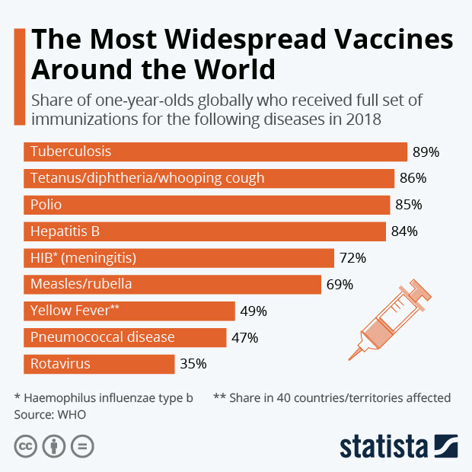

Slide 60

Software, IT, Finance, Media
And communicationsdesigning,
Public Administration,
Entertainment
Can sustain Work at home

Slide 61
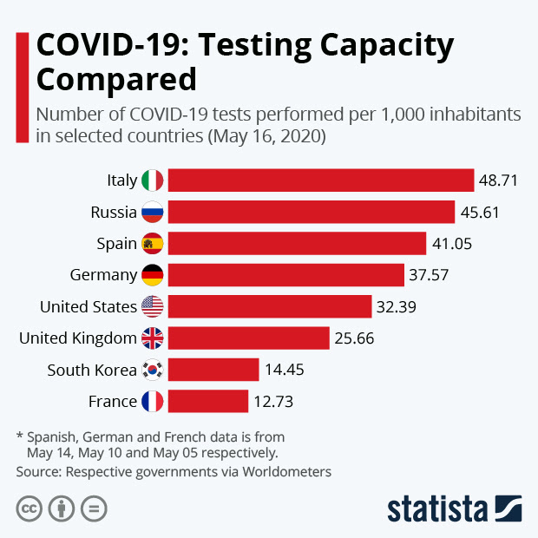
Testing capacities
For Covid19 varies
Across countries
Italy , Russia
Spain Germany, US

Slide 62
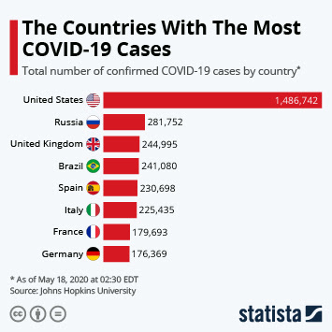

Slide 63
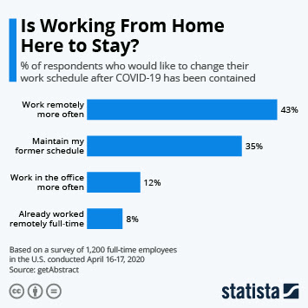

Slide 64
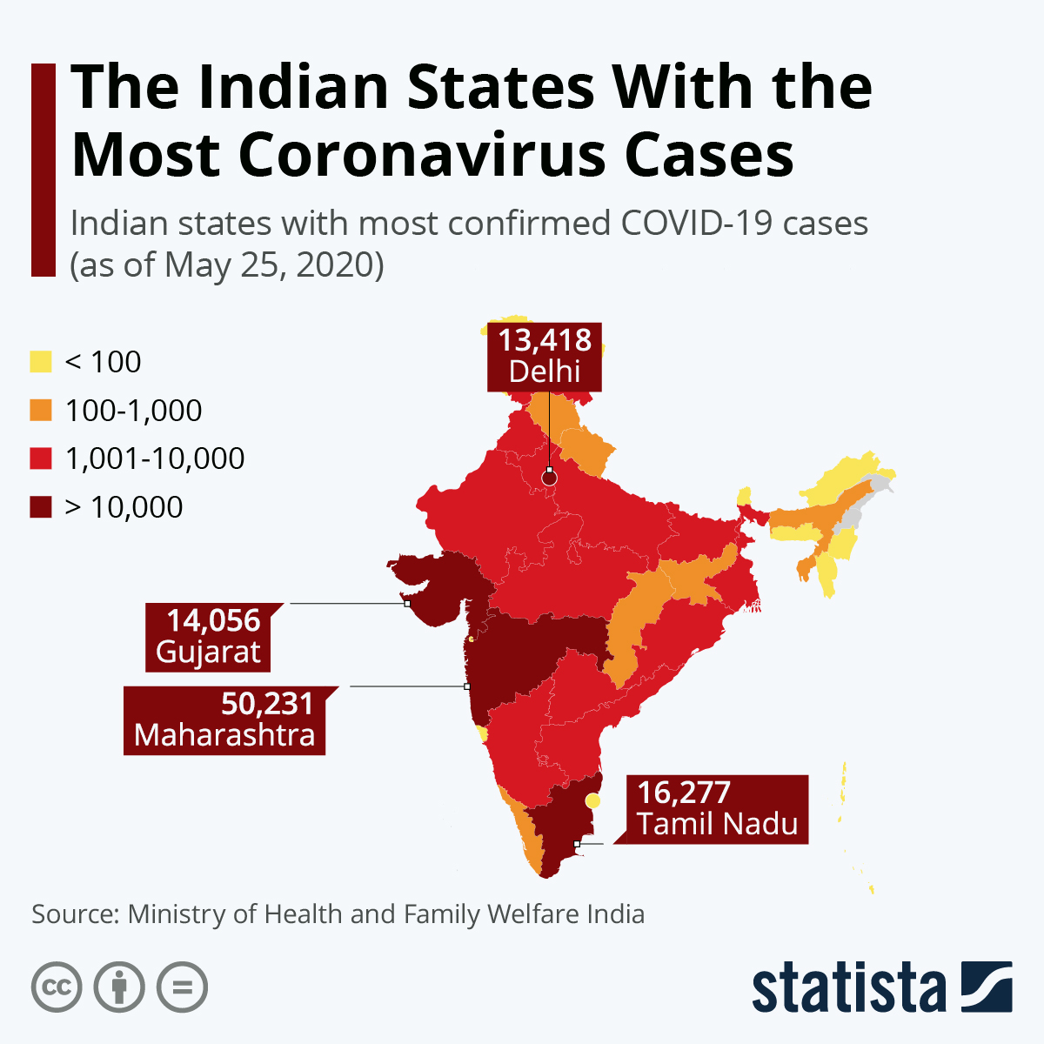

Slide 65
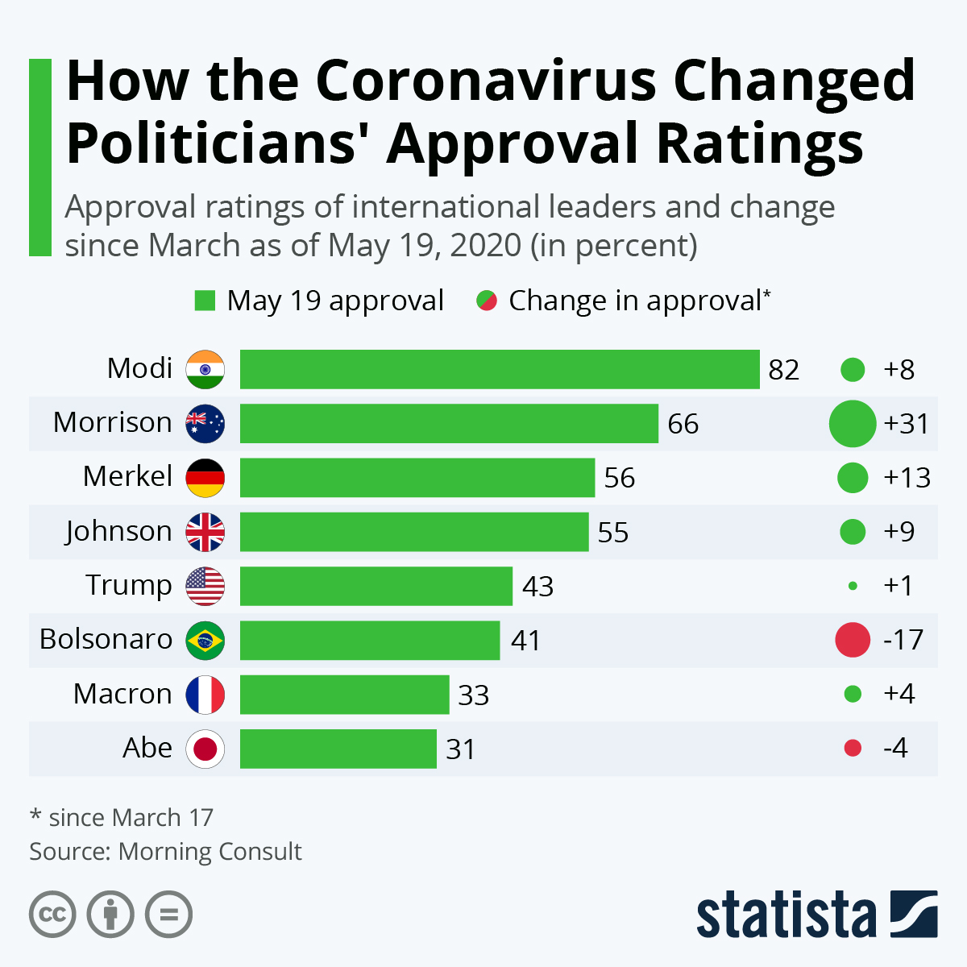

Slide 66
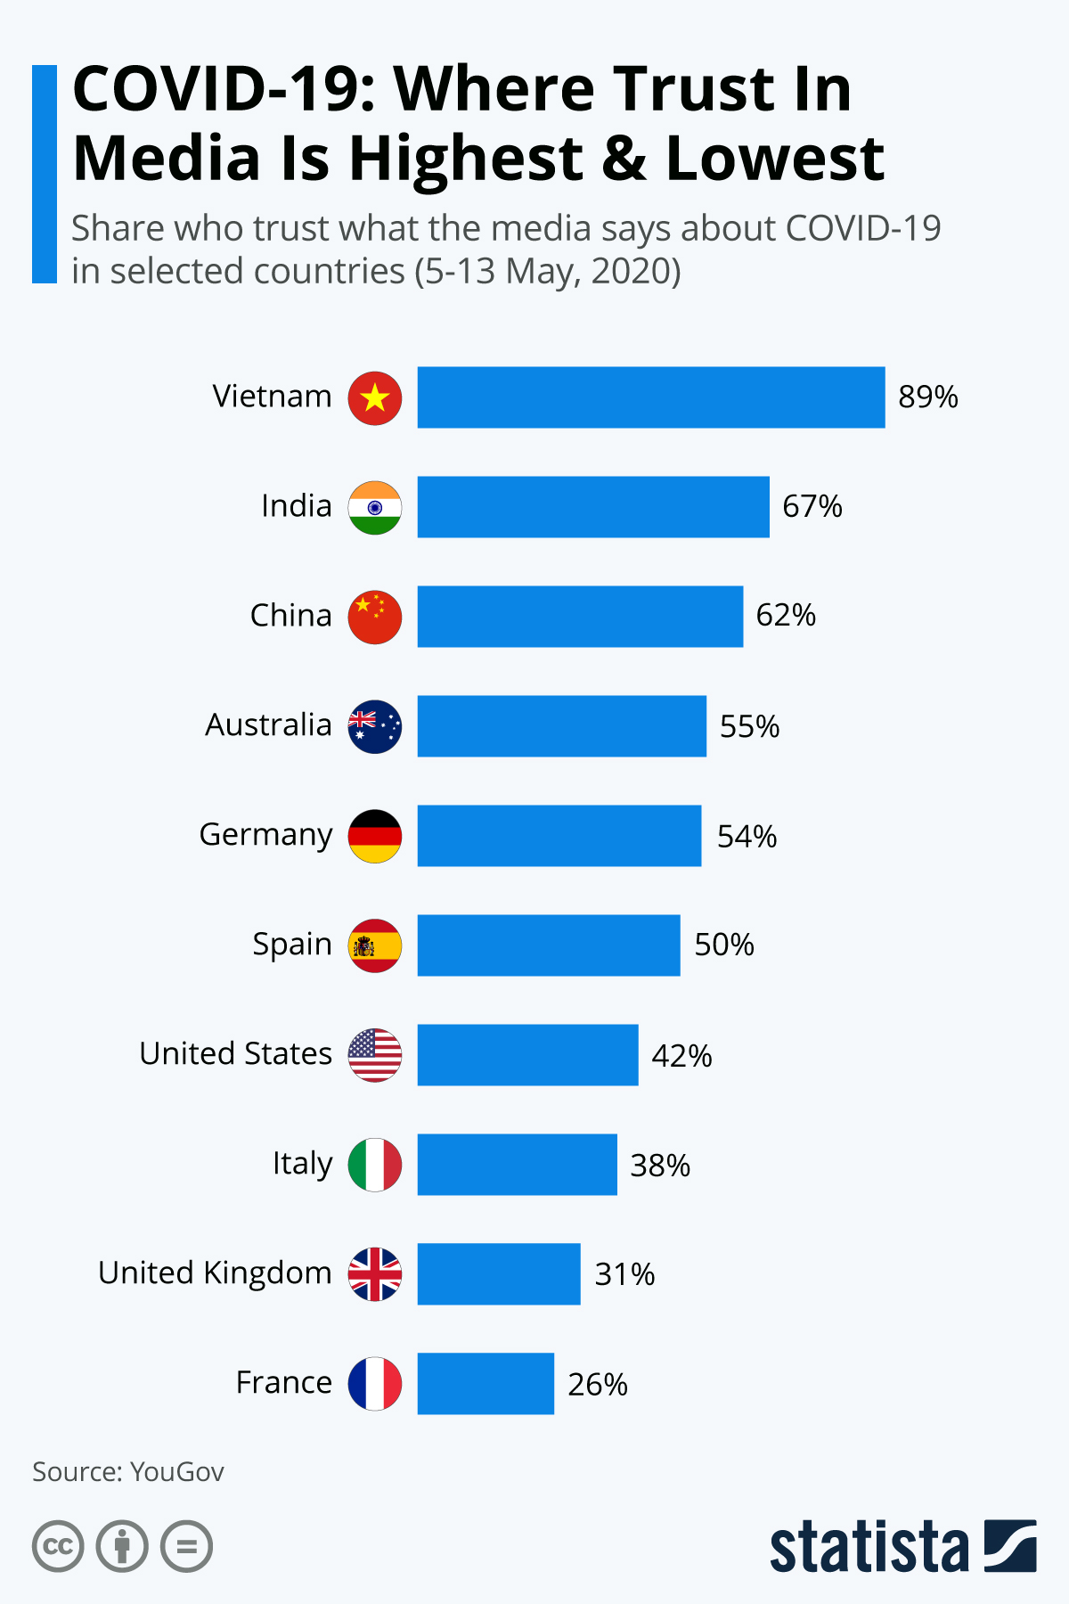
Media trust about Covid19
Is very high in India

Slide 67
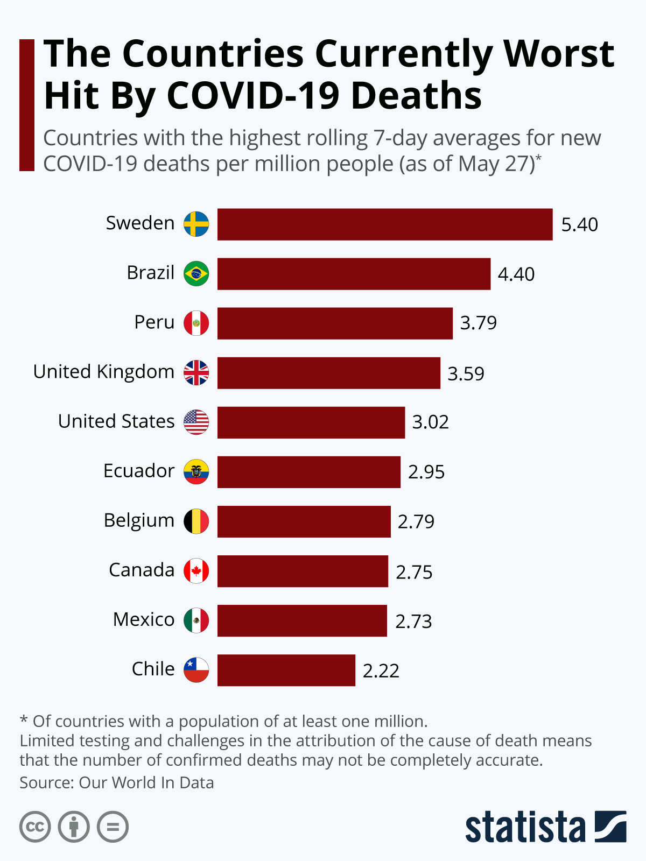

Slide 68
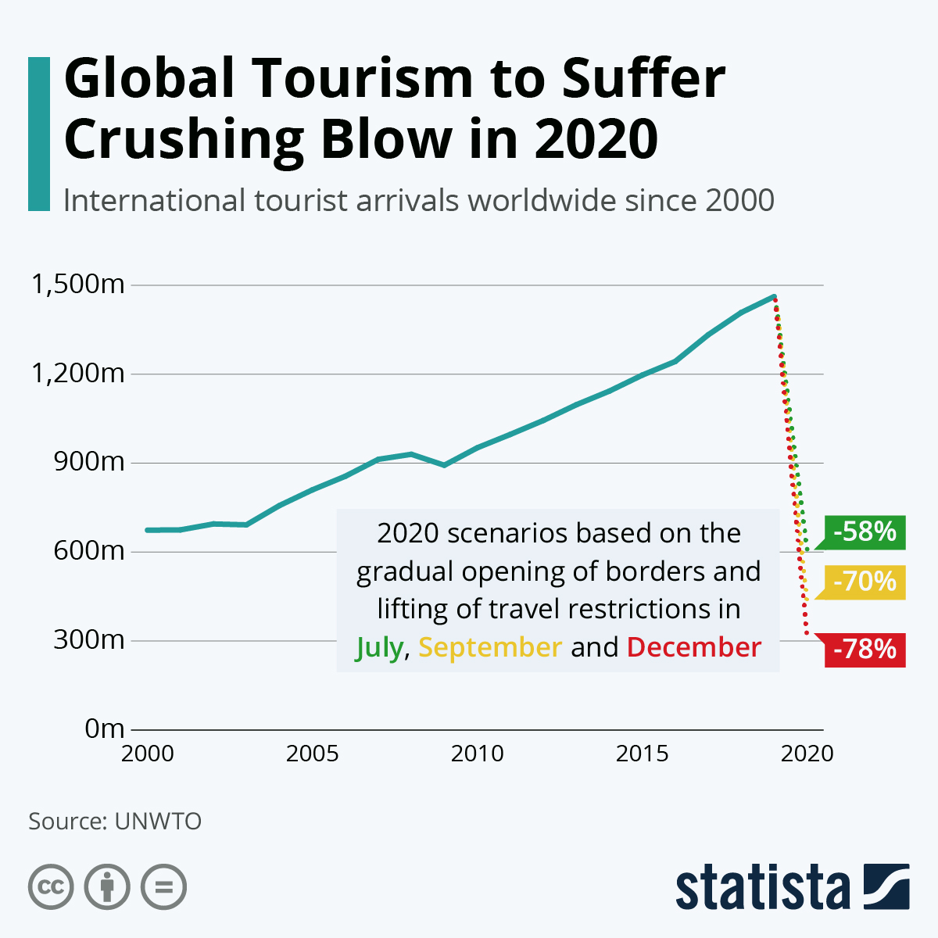
Global Tourism
Fallen by at least
60% due to Covid19

Slide 69
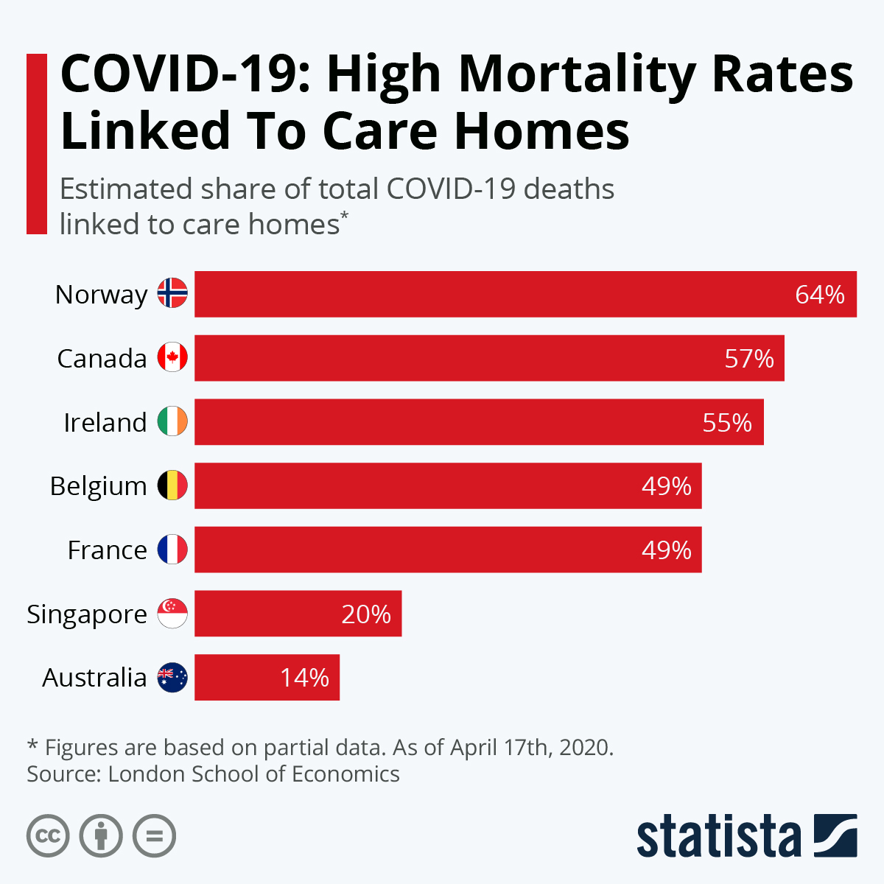
In the US, high mortality
Due to COVID 19
Is linked to people in
Old age homes

Slide 70
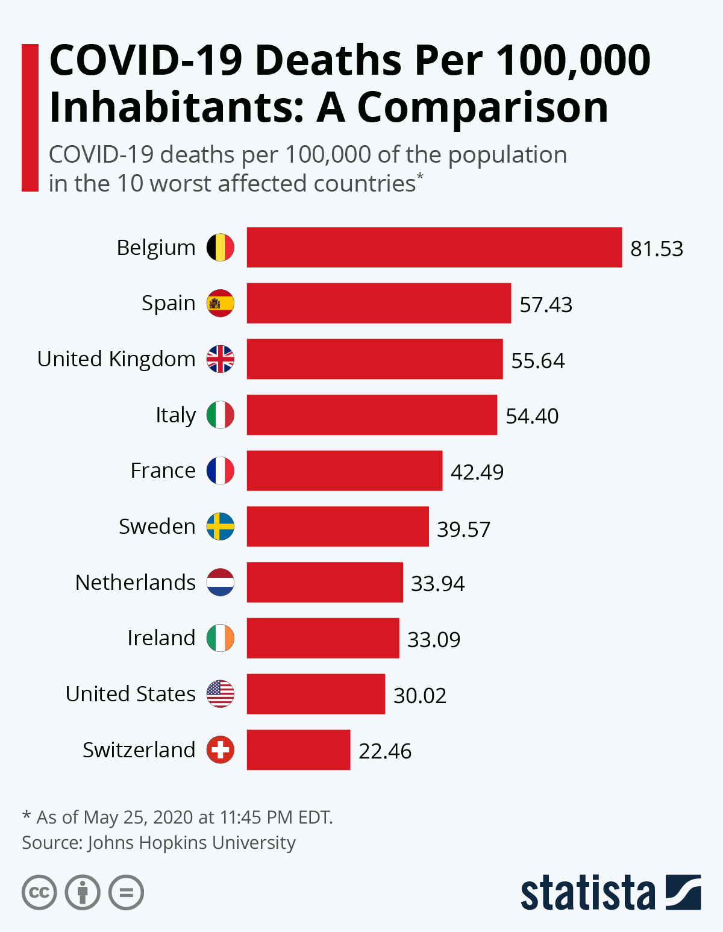

Slide 71
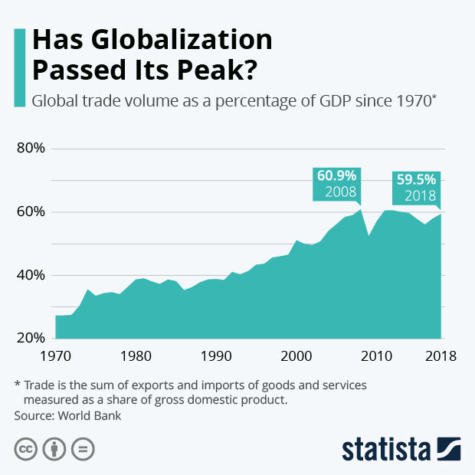

Slide 72
References
Global Economic Effects of COVID-19
Congressional Research Service Report. R 46270, US Government, Washington DC, May 15 2020

Slide 73
Acknowledgement
Thankful to Prof KB Rangappa, Dean of Arts and Chairman of DOE, Davanagere University for providing this opportunity; Shri Chetan Kumar Research Scholar provided able support and am thankful. Thankful to all of you for your patience in listening to this webinar. I am also thankful to my family here in Washington DC for bearing with me some disturbance at midnight 1.30 am

